Slide 1


<Name>
<Date>

Slide 2

Outline
Executive Summary
Introduction
Methodology
Results
Conclusion
Appendix

Slide 3
Executive Summary
Summary of methodologies
Summary of all results

Slide 4
Introduction
SpaceX advertises Falcon 9 rocket launches with much of the savings, becuase SpaceX can reuse the first stage.
We will predict if the Falcon 9 first stage will land successfully.

Slide 5

Section 1

Slide 6
Methodology
Executive Summary
Data collection methodology:
Describe how data was collected
Perform data wrangling
Describe how data was processed
Perform exploratory data analysis (EDA) using visualization and SQL
Perform interactive visual analytics using Folium and Plotly Dash
Perform predictive analysis using classification models
How to build, tune, evaluate classification models

Slide 7
Data Collection
The data is collected in JSON format and using the GET request
Process of data collection process
Request and parse the data using GET request
Filter the dataframe to only include Falcon 9 launches
Dealing with missing values

Slide 8
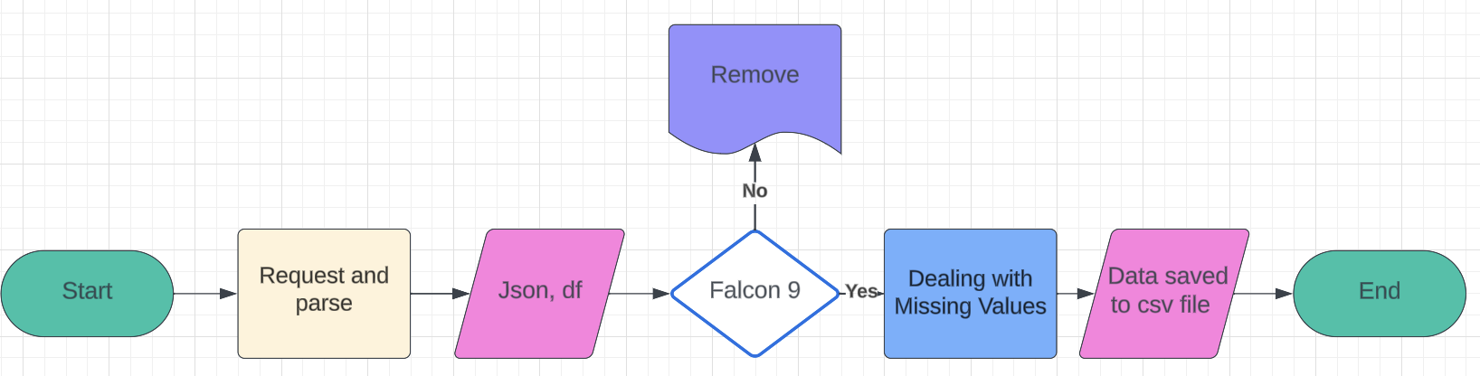
Data Collection – SpaceX API
https://github.com/Sharon-SHH/IBM-DS-Certificate/blob/main/IBM_10_spacex-data-collection-api.ipynb

Slide 9
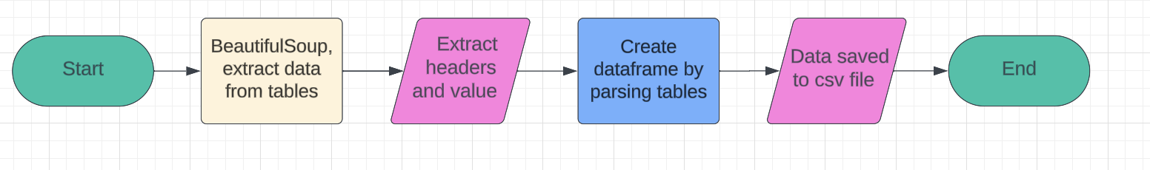
Data Collection - Scraping
Web scrap Falcon 9 records with BeautifulSoup; Extract all data from table; Create a data frame by parsing tables.
https://github.com/Sharon-SHH/IBM-DS-Certificate/blob/main/IBM_10-labs-webscraping.ipynb

Slide 10
Data Wrangling
Exploratory Data Analysis and determine training labels.
Determine the number of Launchsite, Orbit and Outcomes.
https://github.com/Sharon-SHH/IBM-DS-Certificate/blob/main/IBM_10-spacex-Data%20wrangling.ipynb

Slide 11
EDA with Data Visualization
Using sns.catplot to visualize the relationship between Flight Number and Launch Site; the relationship between Payload and Launch Site; Using bar chart to visualize the relationship between success rate of each orbit type. catplot can show the relationship of two variables.
https://github.com/Sharon-SHH/IBM-DS-Certificate/blob/main/IBM_10-dataviz.ipynb

Slide 12
EDA with SQL
SQL Queries
select * from table where Launch_Site
like “CCA%”
limit(5)
sum(Payload_mass_kg)
avg(Payload_mass_kg)
min(Date), count()
https://github.com/Sharon-SHH/IBM-DS-Certificate/blob/main/IBM_10-sql-coursera_sqllite.ipynb

Slide 13
Build an Interactive Map with Folium
Using folium.Map to create map objects; Marker can be used to point the specific location and add the makers to a folium map.
To create a map and create a group of markers on a map.
https://github.com/Sharon-SHH/IBM-DS-Certificate/blob/main/IBM_10_launchSite_location.ipynb

Slide 14
Build a Dashboard with Plotly Dash
List plots/graphs and interactions added to a dashboard:
Dropdownlist
Pie chart
Range Slider
A callback function (interaction)
Display all elements on the page clearly and it’s user-friendly.
https://github.com/Sharon-SHH/IBM-DS-Certificate/blob/main/DV_Final_Assignment_Part_2.py

Slide 15
Predictive Analysis (Classification)
Build a classification model:
Load the data and preprocessing: apply StandardScaler to data
Use train_test_split to split training data and test data.
Create logistic regression model, SVM and decision tree, use training data to train model and get beset parameters.
Create a model, select significant parameters for it and using training data to train the model and get the best parameters.
https://github.com/Sharon-SHH/IBM-DS-Certificate/blob/main/IBM_10SpaceX_Machine_Learning_Prediction_Part_5.ipynb

Slide 16
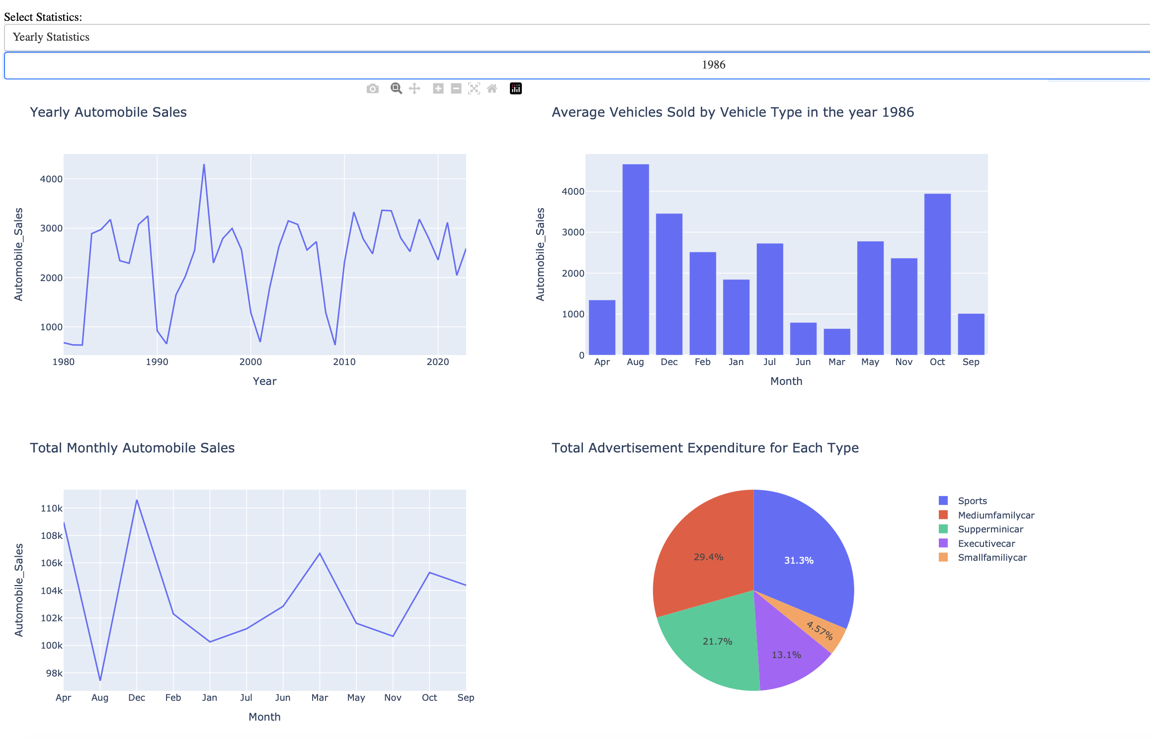
Results
We find that FlightNumber has a great relationship to Orbit.
Applied logistic regression, svm, decision tree, knn models, we find that decision tree gives the best performance.

Slide 17

Section 2

Slide 18
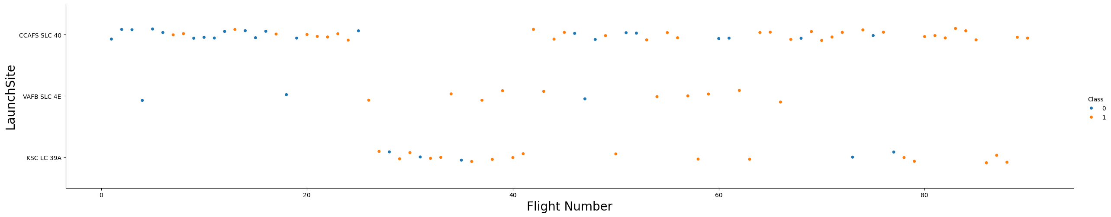
Flight Number vs. Launch Site
A scatter plot of Flight Number vs. Launch Site
X-axis is Flight Number, Y-axis is Launch Site. “CCAFS SLC 40” are mainly selected.

Slide 19
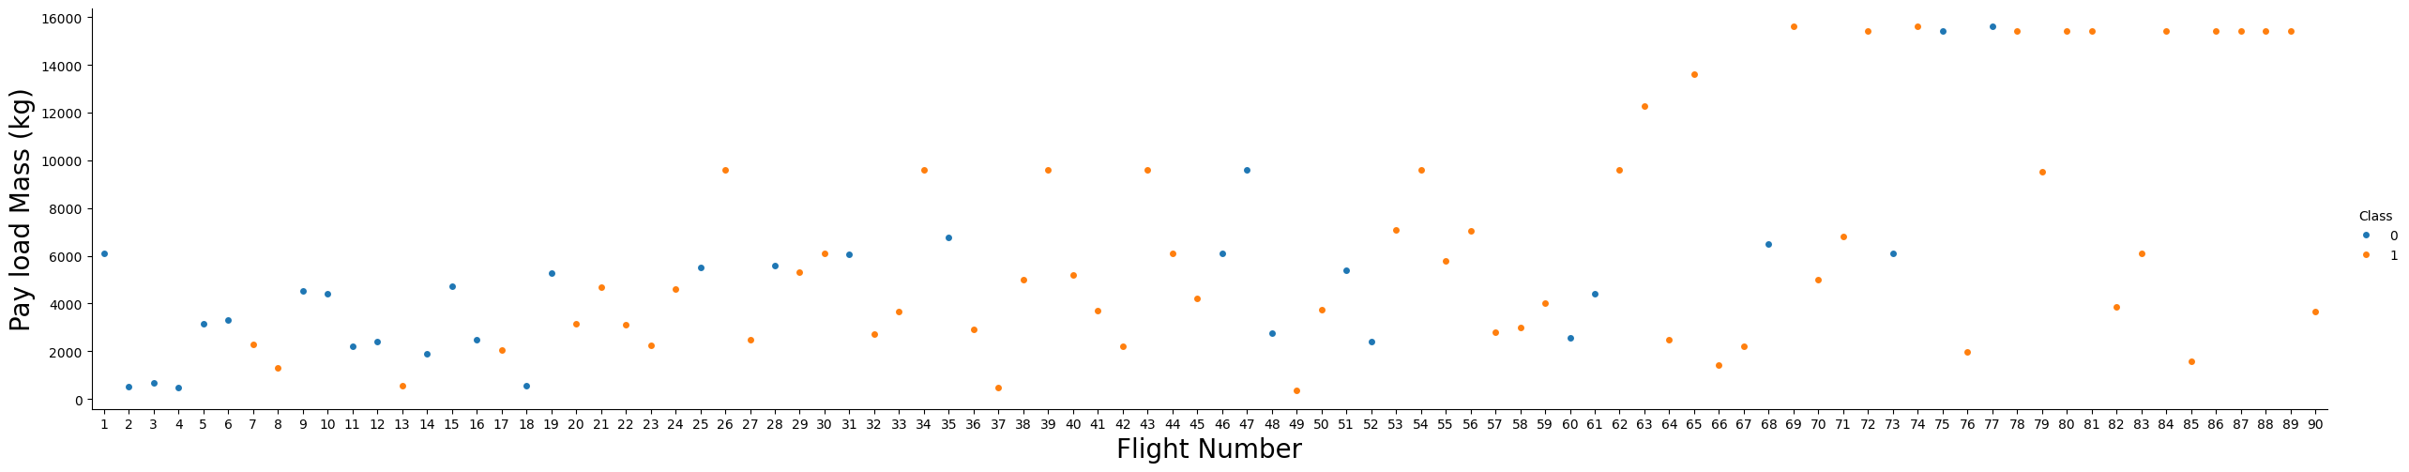
Payload vs. Launch Site
A scatter plot of Payload vs. Launch Site
When Flight Number increases, the first stage is more likely to land successfully. The payload mass is more massive, the first stage will less likely return.

Slide 20
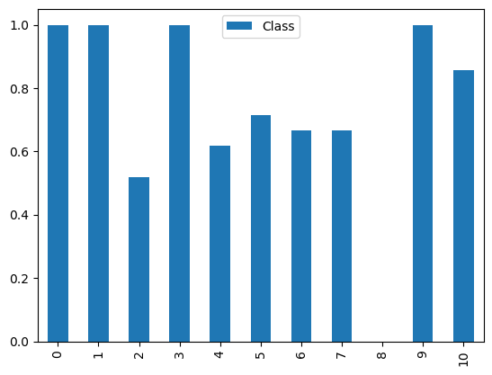
Success Rate vs. Orbit Type
A bar chart for the success rate of each orbit type
Most of orbits have high success rate, except 8th-MEO of the orbits.

Slide 21
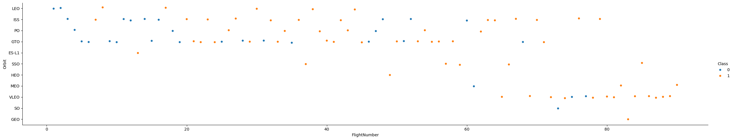
Flight Number vs. Orbit Type
A scatter point of Flight number vs. Orbit type
When Flight number is between 20 to 60 and orbits are included in LEO, ISS, PO, GTO, the first stage has a bigger success rate. When Flight number is greater than 60, it also has a bigger success rate.

Slide 22
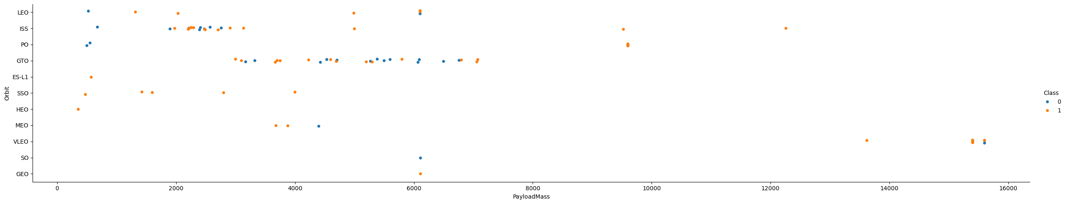
Payload vs. Orbit Type
A scatter point of payload vs. orbit type
With heavy payloads the successful landing or positive landing rate are more for PO (polar), LEO and ISS.

Slide 23
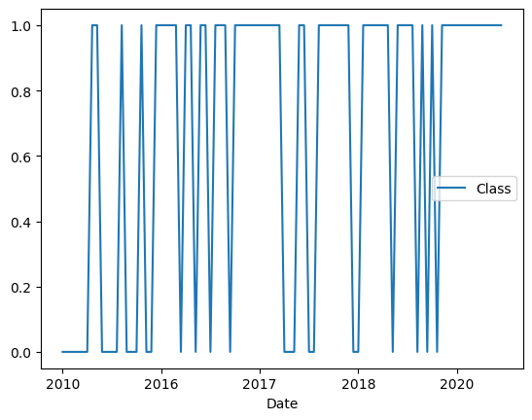
Launch Success Yearly Trend
A line chart of yearly average success rate
The success rate since 2013 kept increasing till 2020.

Slide 24
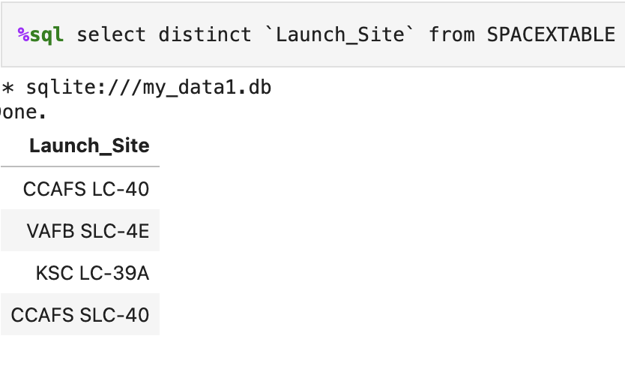
All Launch Site Names
The unique launch sites
distinct to get unique elements

Slide 25
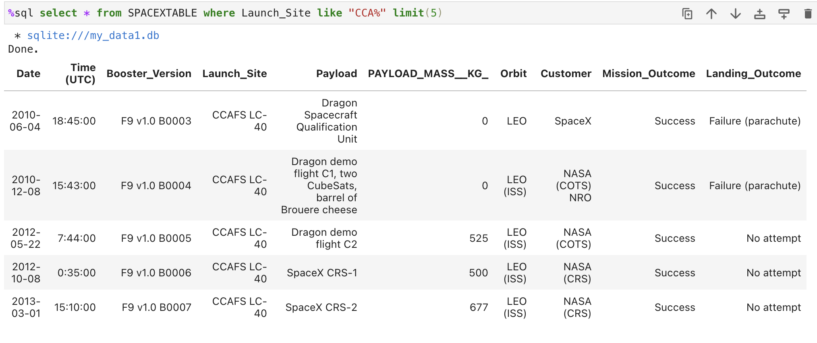
Launch Site Names Begin with 'CCA'
Find 5 records where launch sites begin with `CCA`
Display 5 records where launch sites begin with `CCA`

Slide 26
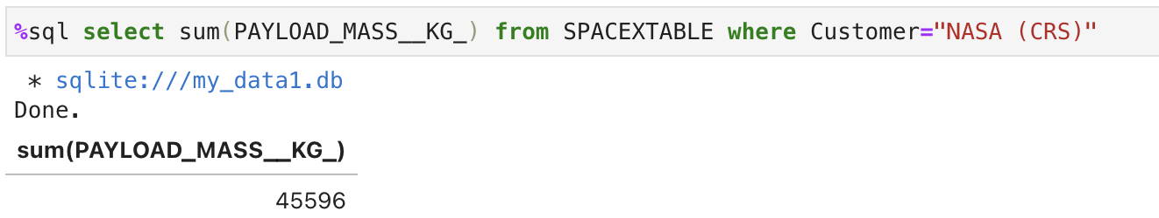
Total Payload Mass
Calculate the total payload carried by boosters from NASA
Use sum() to compute the total payload carried from NASA

Slide 27
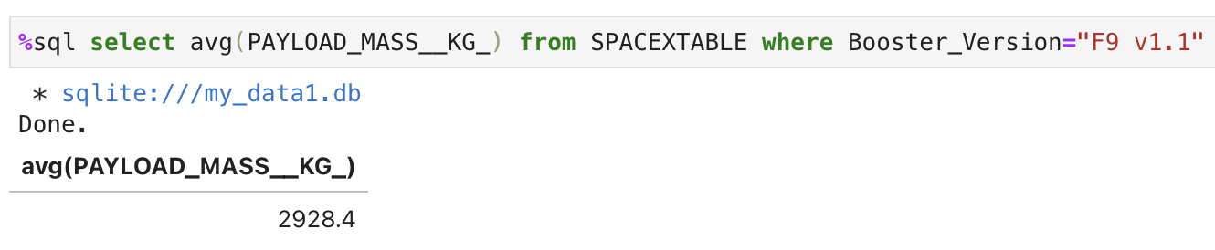
Average Payload Mass by F9 v1.1
Calculate the average payload mass carried by booster version F9 v1.1
Use avg() to compute the average payload mass.

Slide 28
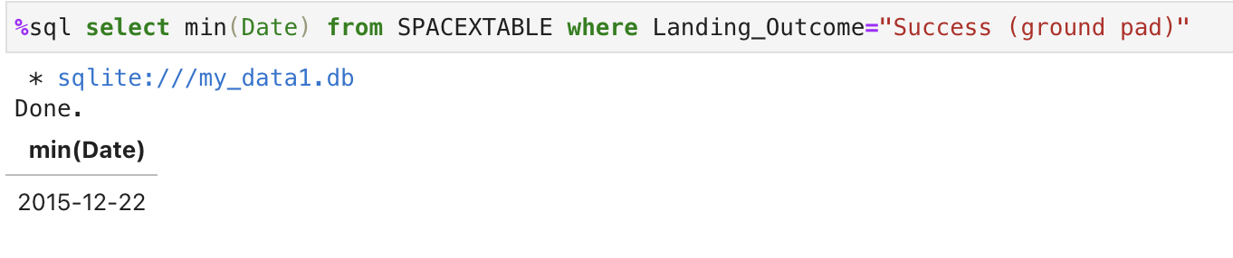
First Successful Ground Landing Date
Find the dates of the first successful landing outcome on ground pad
To get the first successful landing outcome, use min() to get the earliest date.

Slide 29
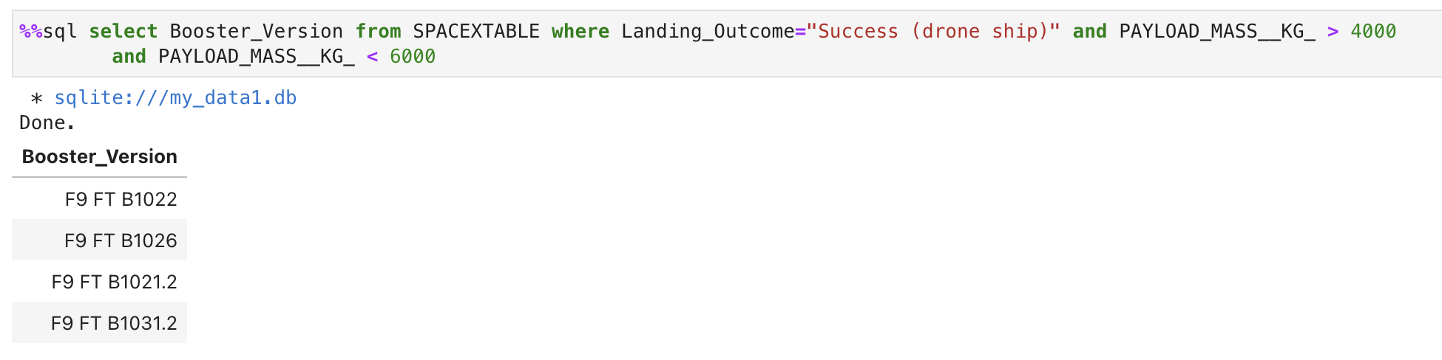
Successful Drone Ship Landing with Payload between 4000 and 6000
List the names of boosters which have successfully landed on drone ship and had payload mass greater than 4000 but less than 6000
Present your query result with a short explanation here

Slide 30
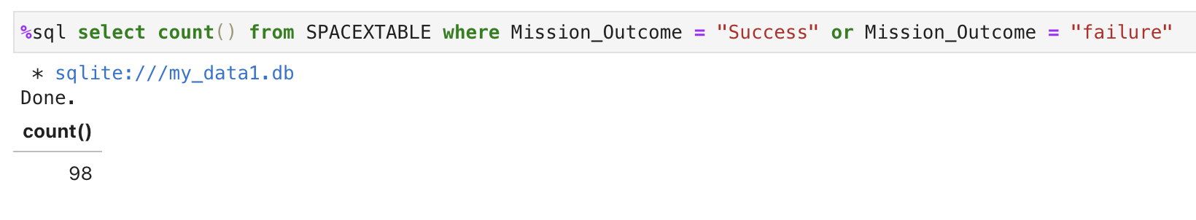
Total Number of Successful and Failure Mission Outcomes
Calculate the total number of successful and failure mission outcomes
To get both successful and failure mission outcomes, use count() and or in the where condition.

Slide 31
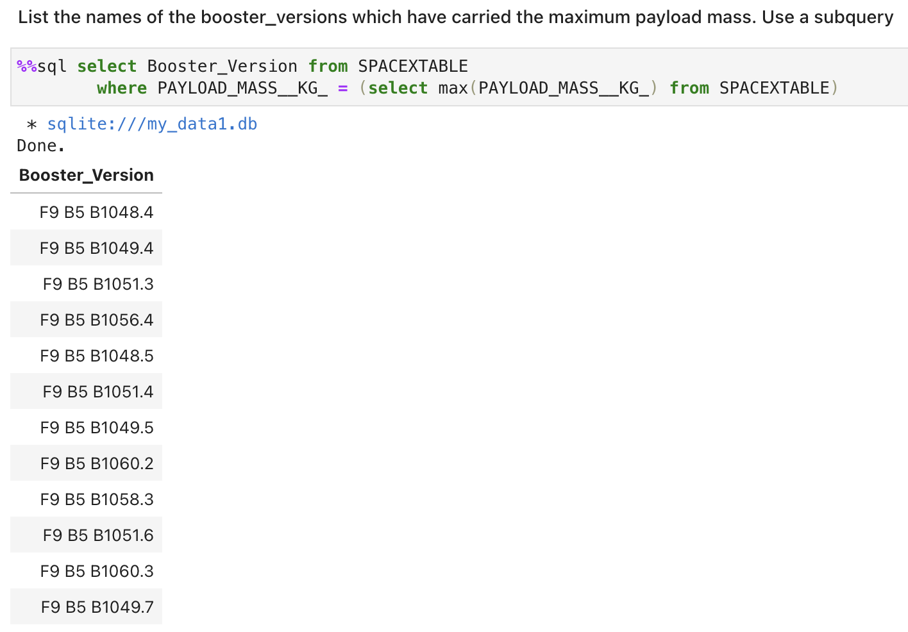
Boosters Carried Maximum Payload
List the names of the booster which have carried the maximum payload mass
Use a subquery to get the maximum of payload mass, the retrieve the names of the boosters.

Slide 32
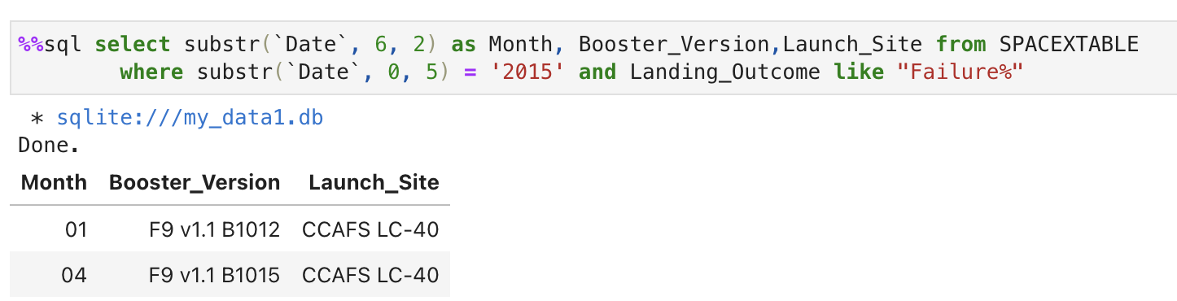
2015 Launch Records
List the failed landing_outcomes in drone ship, their booster versions, and launch site names for in year 2015
Use substr() to get Month and Year; there’re two conditions in this query.

Slide 33
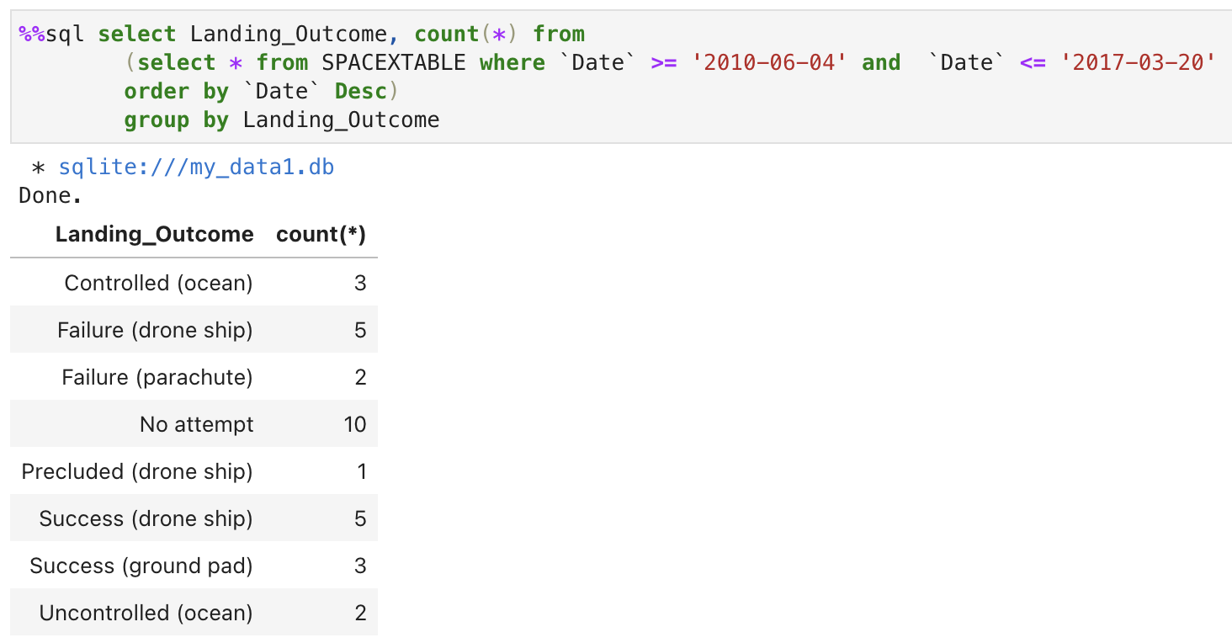
Rank Landing Outcomes Between 2010-06-04 and 2017-03-20
Rank the count of landing outcomes (such as Failure (drone ship) or Success (ground pad)) between the date 2010-06-04 and 2017-03-20, in descending order

Slide 34

Section 3

Slide 35
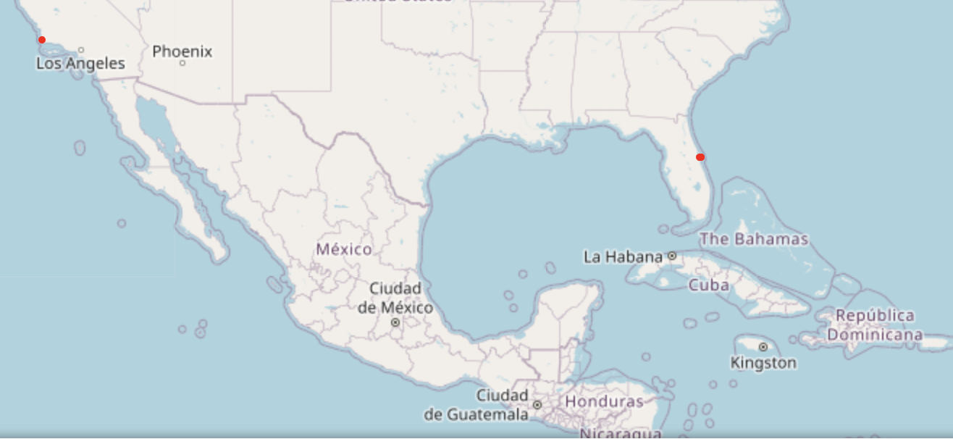
Launch Sites on a global map
We can only see two points on the map, but there are four points on it. Because two points are much closer.

Slide 36
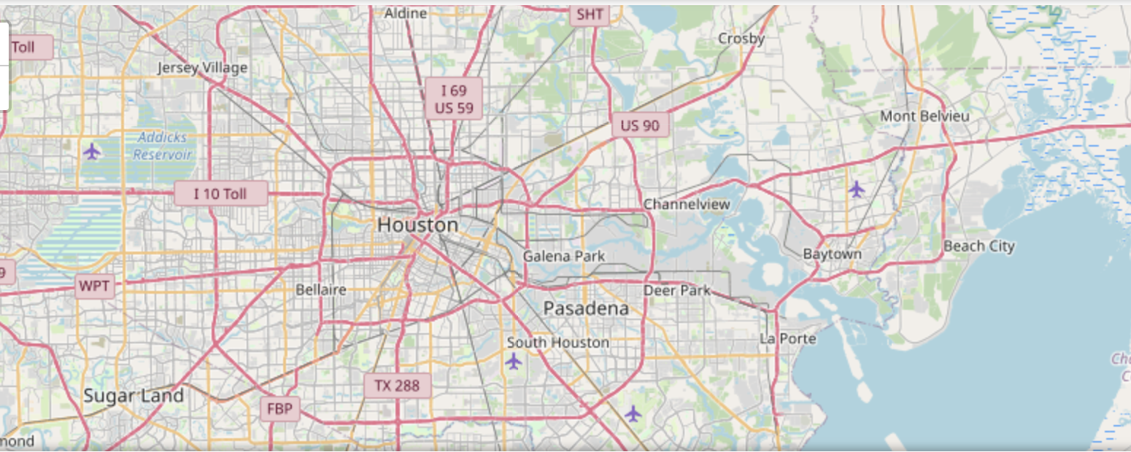
Locat to NASA Johnson Space Center at Houston, Texas
Replace <Folium map screenshot 1> title with an appropriate title
Explore the generated folium map and make a proper screenshot to include all launch sites’ location markers on a global map
Explain the important elements and findings on the screenshot

Slide 37
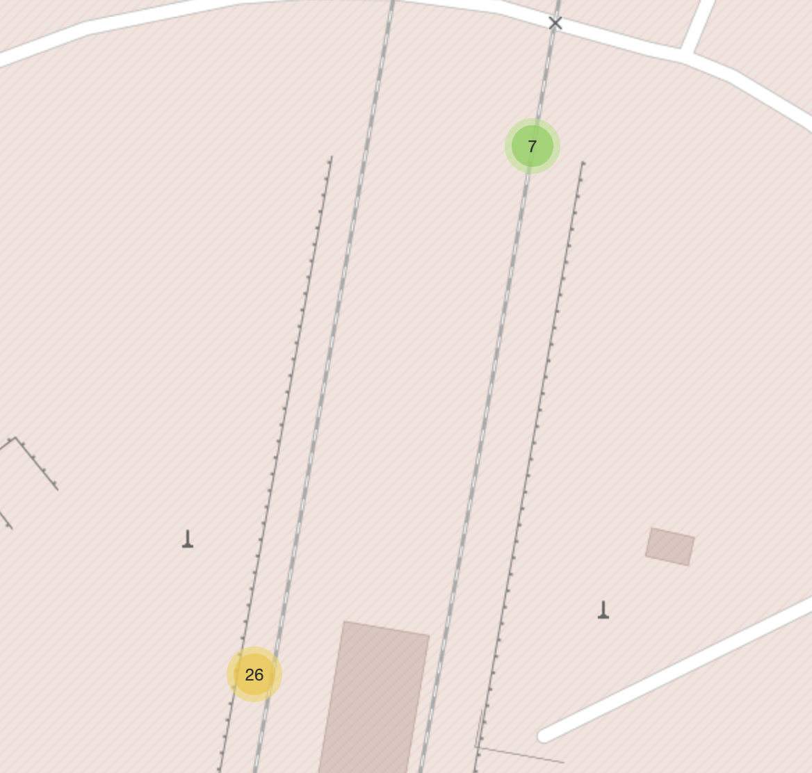
Label success/failure of the launch
If a launch is successful, “class=1” and label is in green marker.
If a launch is failed, “class=0” and label is in red marker.

Slide 38
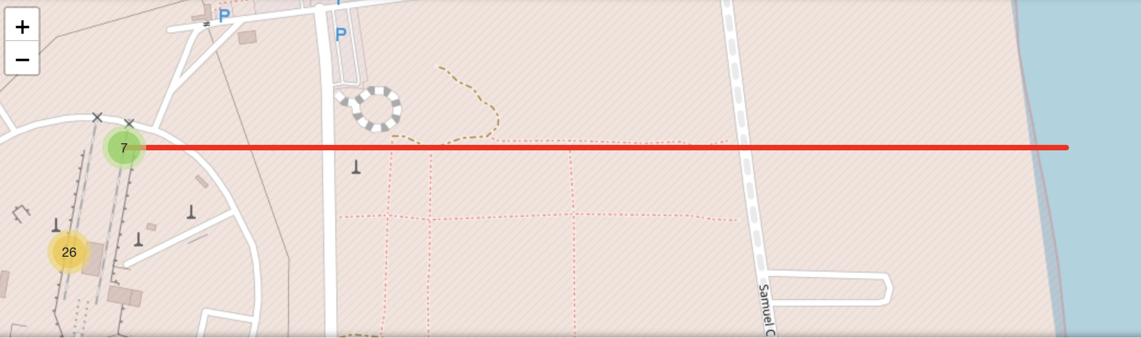
Draw the distances between a launch site to the closest coast
Find coordinate of the closest coastline and use PolyLine to draw the distance between a launch site to the closest coast.

Slide 39

Section 4

Slide 40
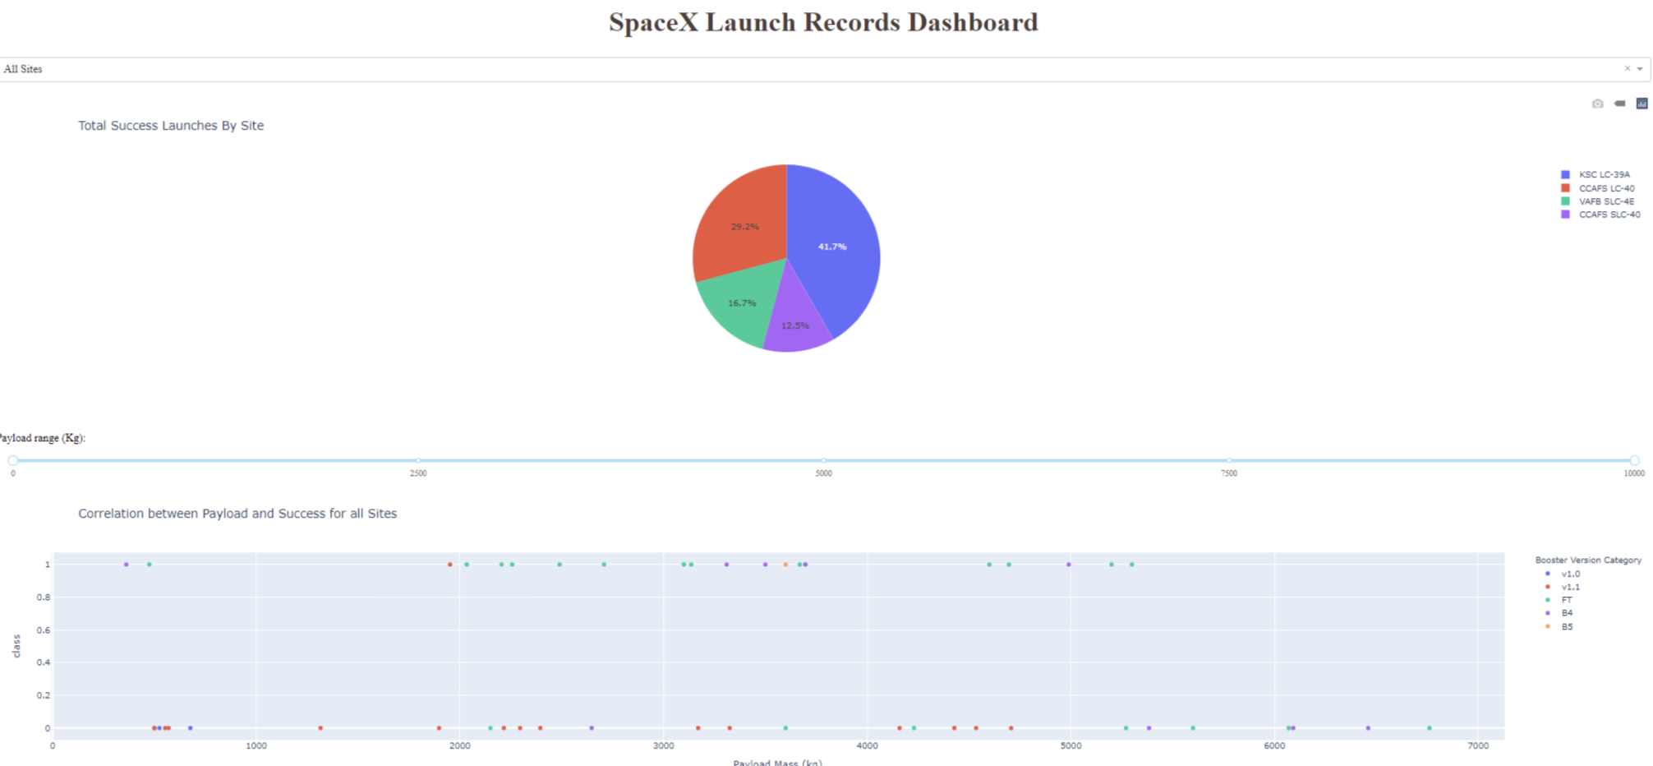
SpaceX Launch Records Dashboard
Total success Launches by site

Slide 41
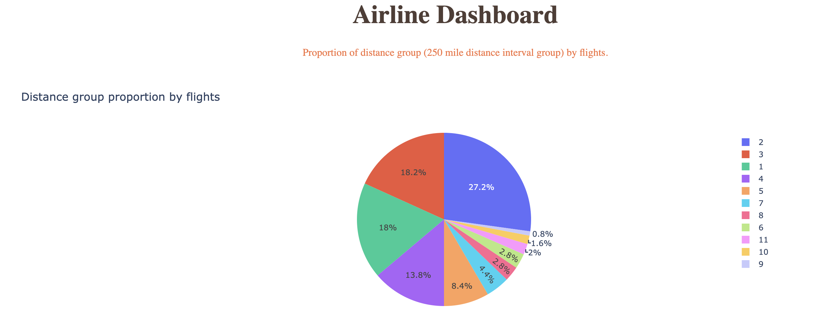
Airline Dashboard
Distance group proportion by flights

Slide 42
Range Slider to Select Payload
Payload vs. Launch Outcome scatter plot for all sites, with different payload selected in the range slider
With heavy payloads the successful landing or positive landing rate are more for Polar, LEO and ISS.

Slide 43

Section 5

Slide 44
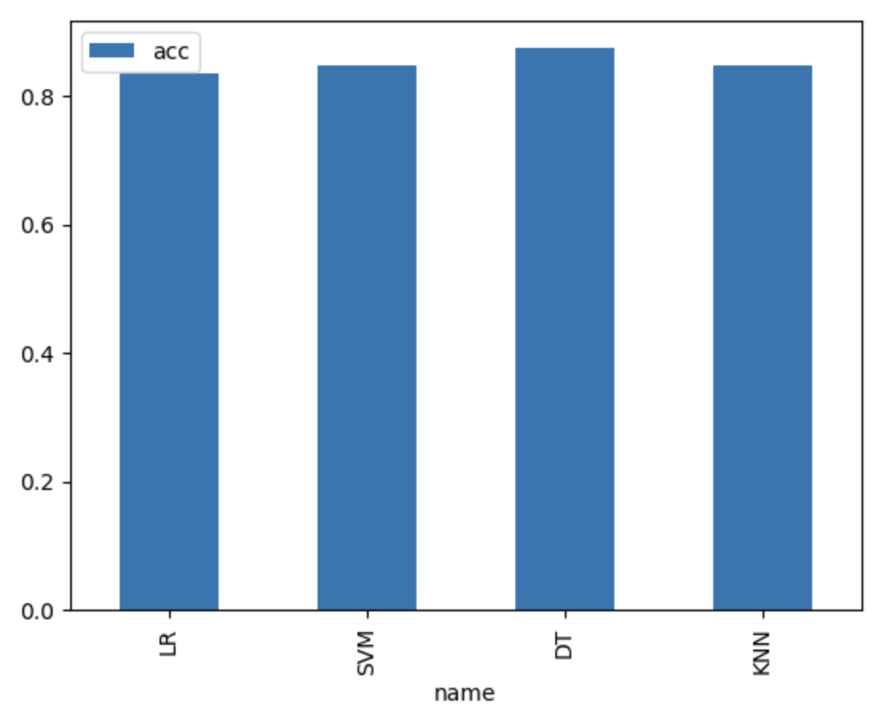
Classification Accuracy
For models as shows in the bar chart, Decision Tree gives the best classification accuracy.

Slide 45
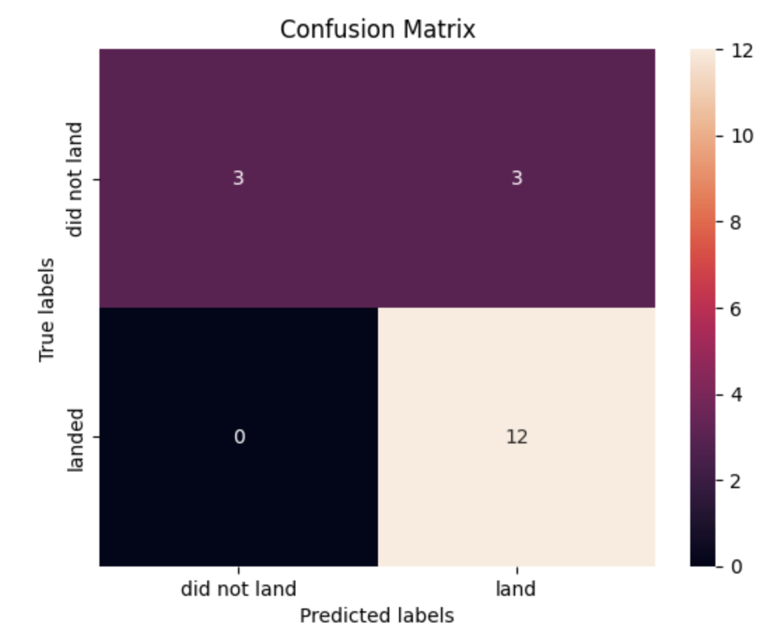
Confusion Matrix
TP=3, TN=12, FN=3, FP=0
acc = (TP + TN)/(TP+TN+FN+FP)
precision = TP/(TP+FP) = 1
recall = TP/(TP+FN) = 0.5
It is concluded that the precision is excellent, but the recall is satisfactory.

Slide 46
Conclusions
SpaceX Falcon 9 works well in first stage landing.
Flight number, Payload, and Orbit Type impact the success of the launches.
Decision Tree yields optimal performance when predicting the success of a landing.

Slide 47
Appendix
https://github.com/Sharon-SHH/IBM-DS-Certificate/tree/main

Slide 48


